Slide 1
Characterization of
Angular Rate Sensors
ADXRS300 & BOSCH SMG040
Sensors And Actuators
Aadithya Ramamurthy | Matrikel Nr. 3304090
Amod Raut | Matrikel Nr. 3297221
Samir Elsafi | Matrikel Nr. 3101566
Date - 17.01.2022

Slide 2
Contents
Introduction
Main characteristic parameters
Measurement Setup
Measuring strategy
State Flow Diagram
Front panel
Block Diagram of VI
ADXRS 300 Results
Bosch SMG040 Results
Conclusion

Slide 3
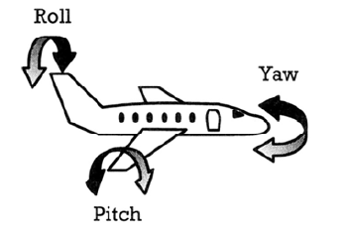
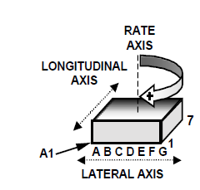
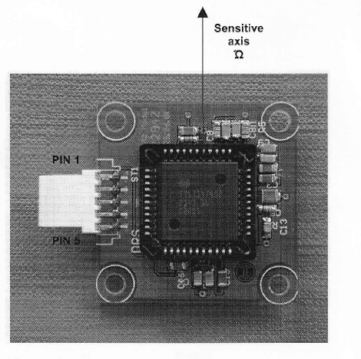
Introduction
Angular Rate Sensor-
Angular Rate Sensors measure the rate of rotation of an object with respect to an inertial frame of reference(yaw, pitch, roll)
They are very important components in active suspension systems and anti-skidding systems, like the ESP system for automobiles.
The ADXRS 300 is an angular rate sensor (gyroscope) that uses Analog Devices’ surface-micro-machining process
ADXRS300 measures along the axis normal to the top surface.
The Robert Bosch Angular Rate Sensor SMG040 is the second generation of gyroscopes for rollover applications. The SMG040 is a micro-machined gyroscope for the detection of angular rates in car safety applications such as rollover control units.
SMG040 sense along the axis shown in figure.

Slide 4
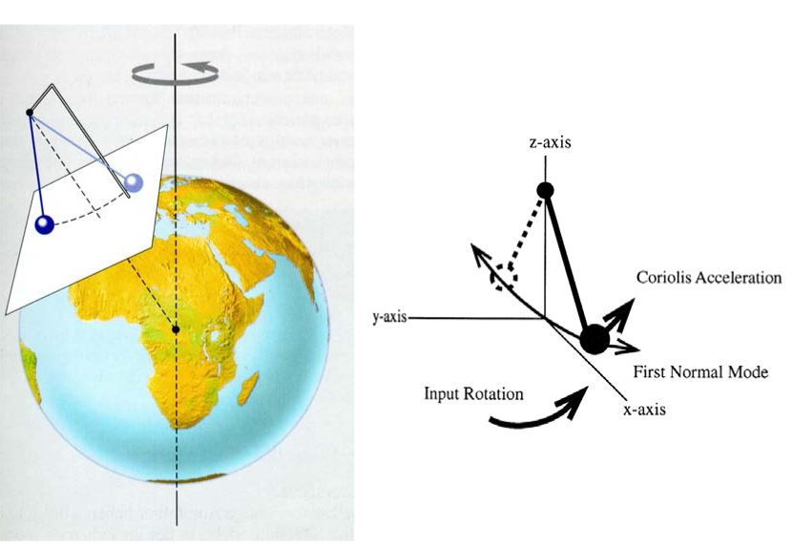
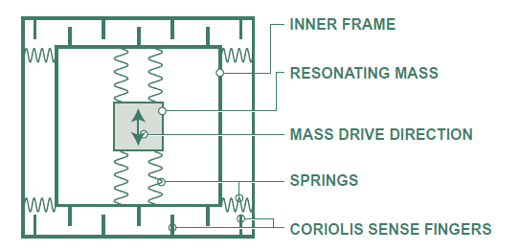
Coriolis Force
The frame containing the resonating mass is tethered to the substrate by springs at 90
Coriolis sense fingers are used to sense displacement of the frame in response to the force exerted by the mass, capacitively.
As the rate of rotation increases, so does the displacement of the Mass, and the Signal derived from the corresponding capacitance change.

Slide 5
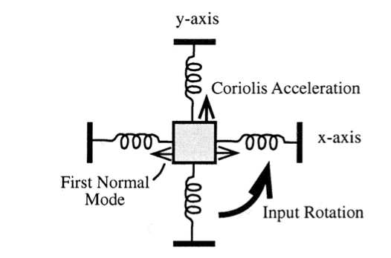
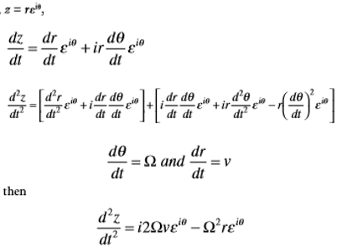
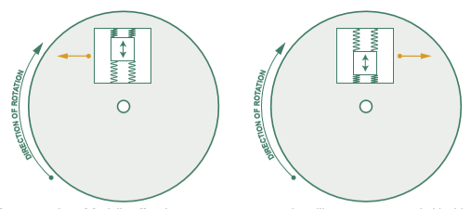
Coriolis Force
The Coriolis force is calculated using –
Demonstration of Coriolis effect in response to the resonating silicon mass supported inside a frame. Orange arrow indicates the force applied.

Slide 6
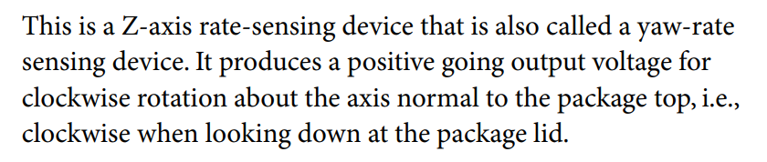
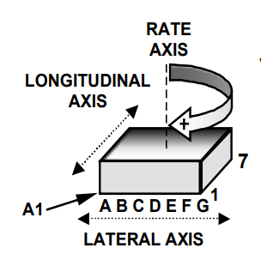
Rate Sensitive Axis
ADXRS300

Slide 7
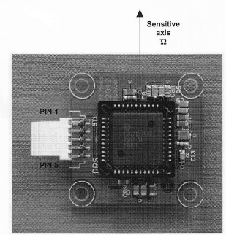
Rate Sensitive Axis
Bosch SMG040
Target Application: Roll over sensing (250 °/s)

Slide 8

Main characteristic parameters
Range of operation
Zero Value voltage
Sensor sensitivity

Slide 9
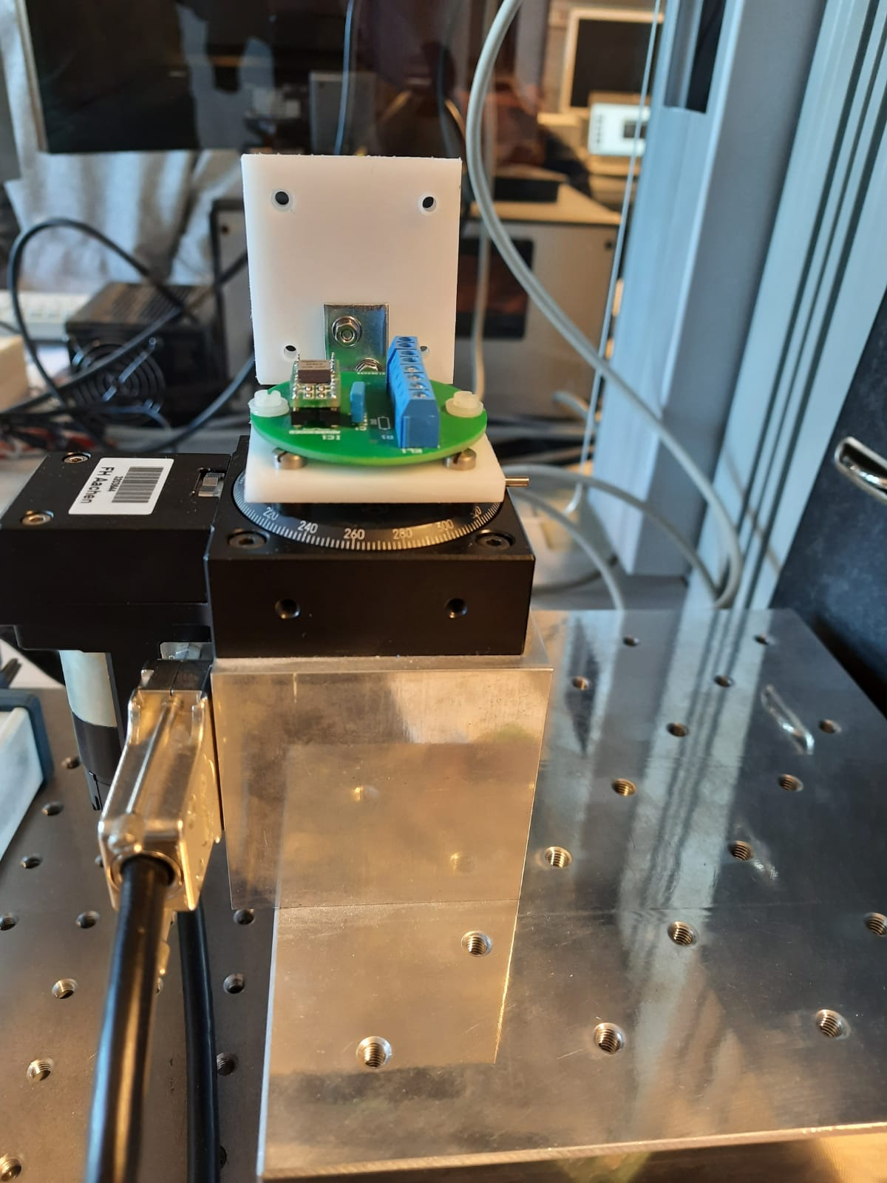
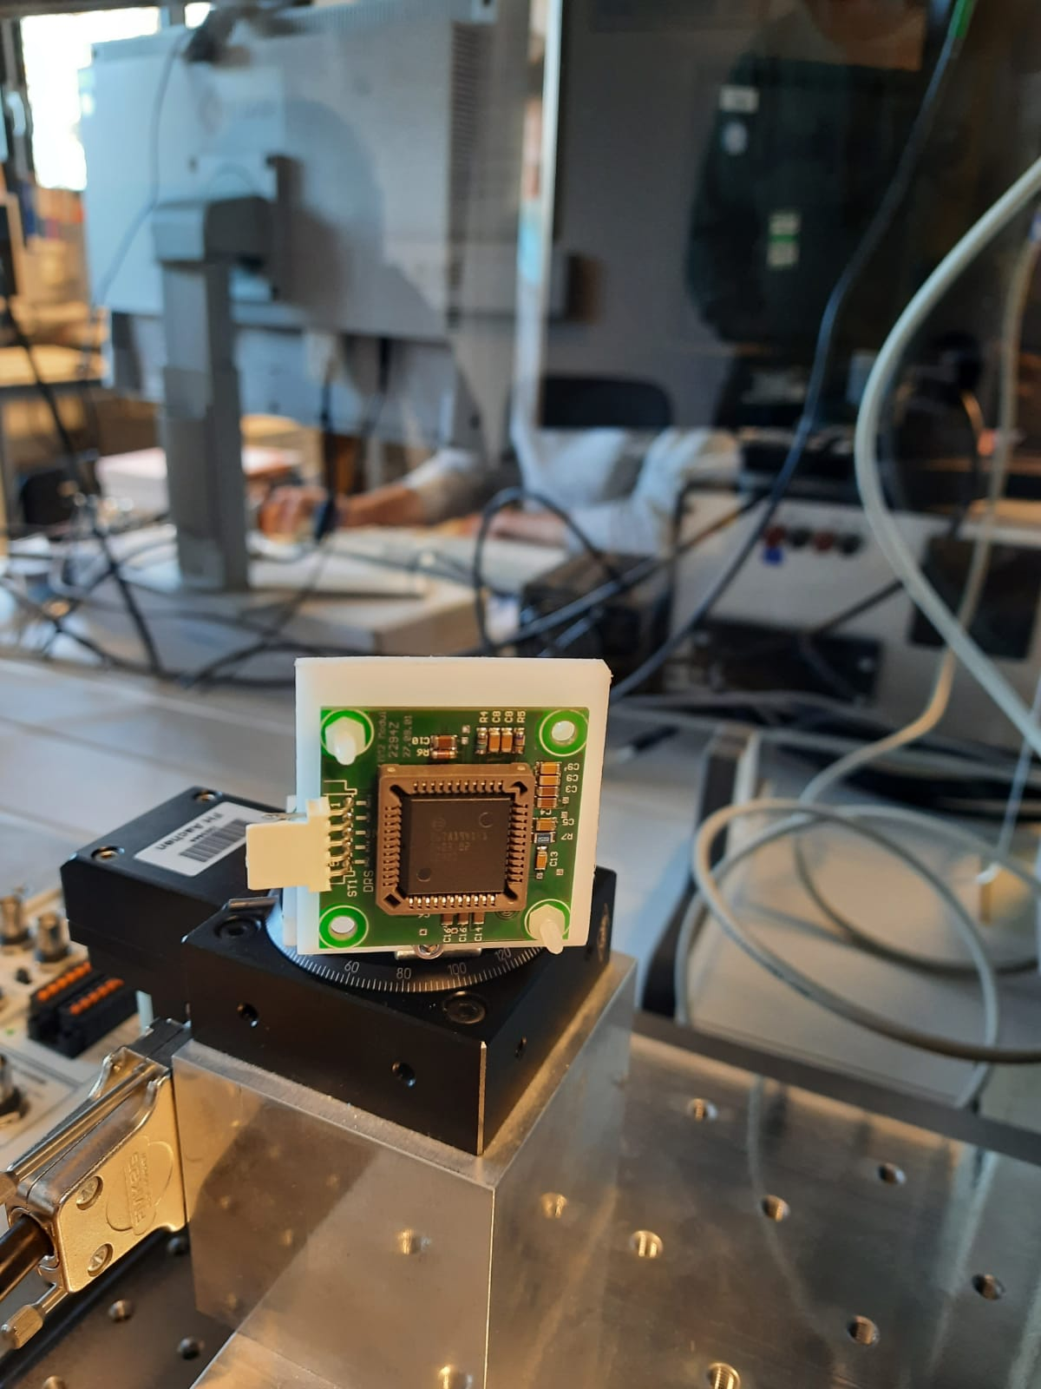
Measurement Setup
For ADXRS300, we use the mounting shown in the figure. We have used 5mm spacers for isolating the sensor terminals.
For Bosch SMG040 we mount it vertically as the sensitive axis is horizontal to the chip.

Slide 10
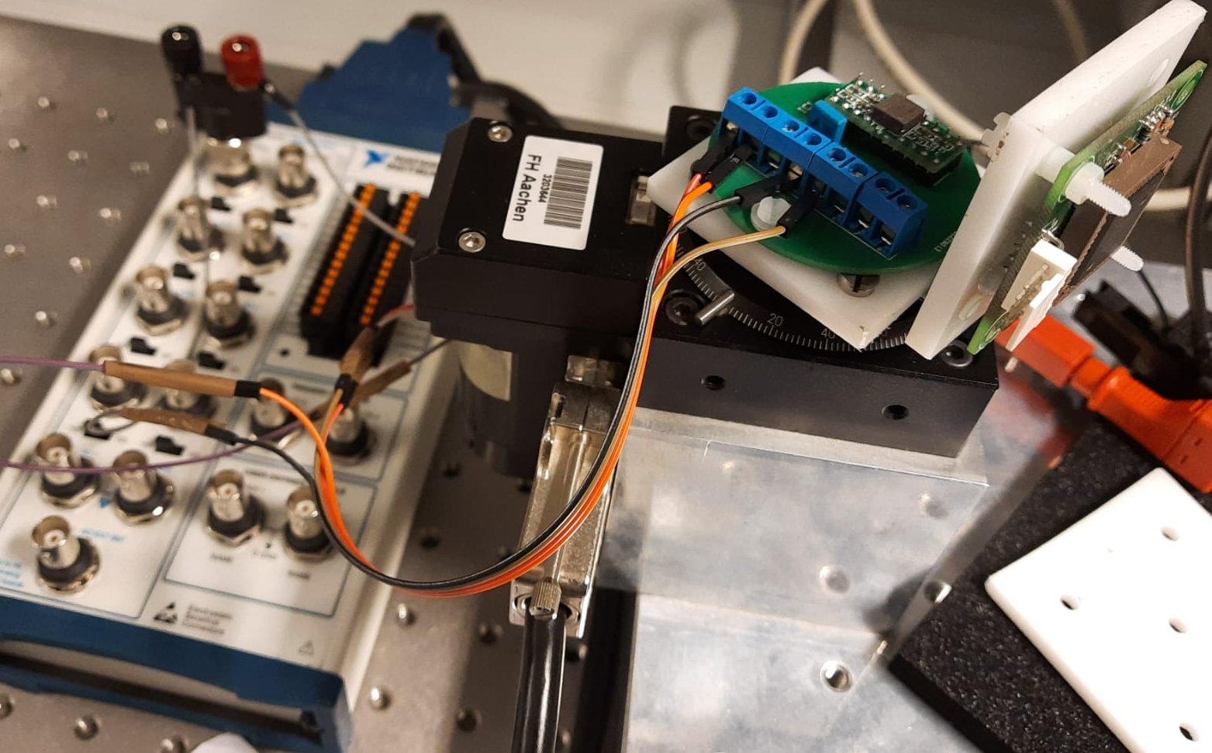
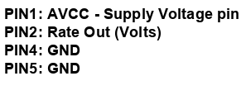
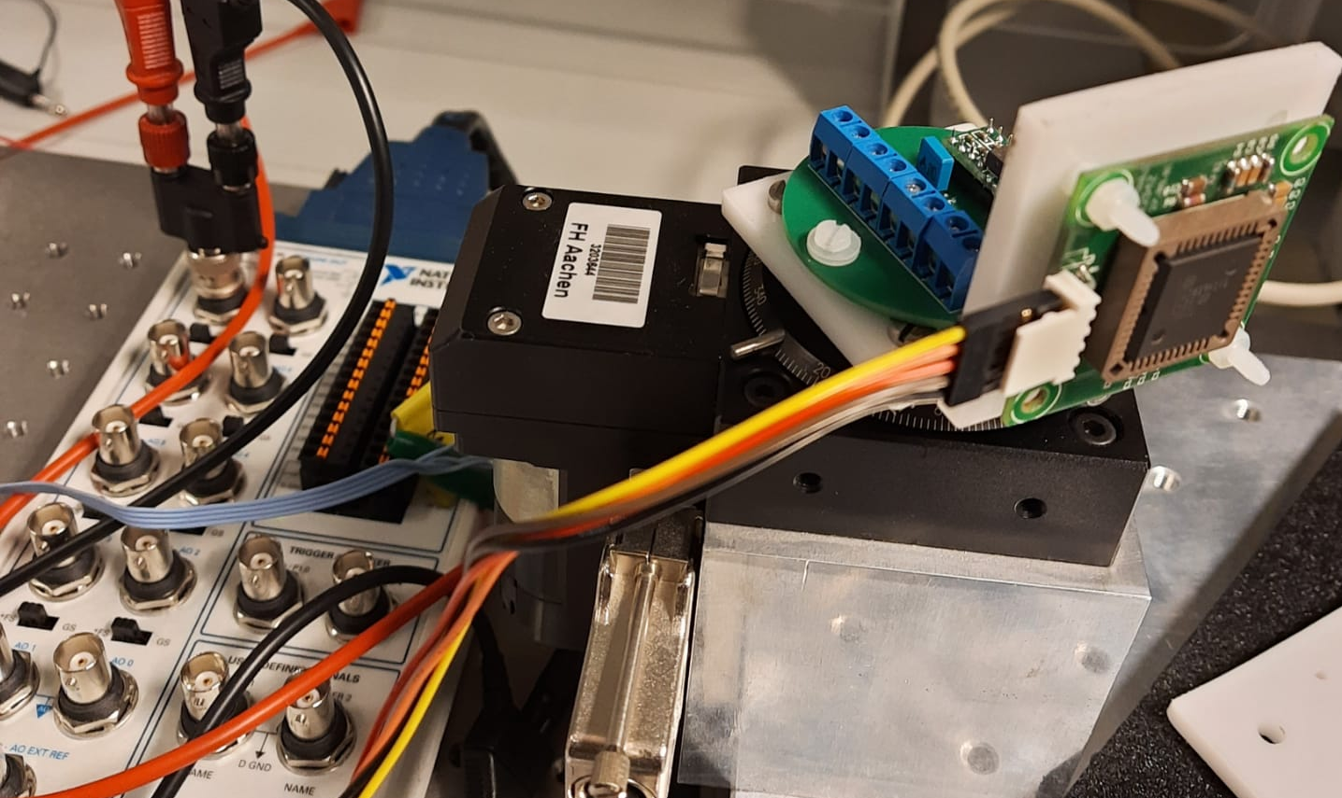

Measurement Setup
ADXRS 300
Bosch SMG040

Slide 11
Measurement Strategy
Rotate the turn table via LabView:
  Rotate by:
    A certain number of turns.
    At a certain speed, specified in LabView giving input - dValue
    dValue in ≈ Angular Rate / 7,06
Read out Voltage of the sensors.
Calculate Angular Velocity of the Turn table.
Calculate Sensitivity of the sensor.

Slide 12
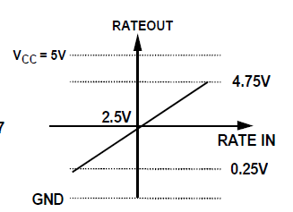
Expected Results
Output voltage vs Angular rate

Slide 13
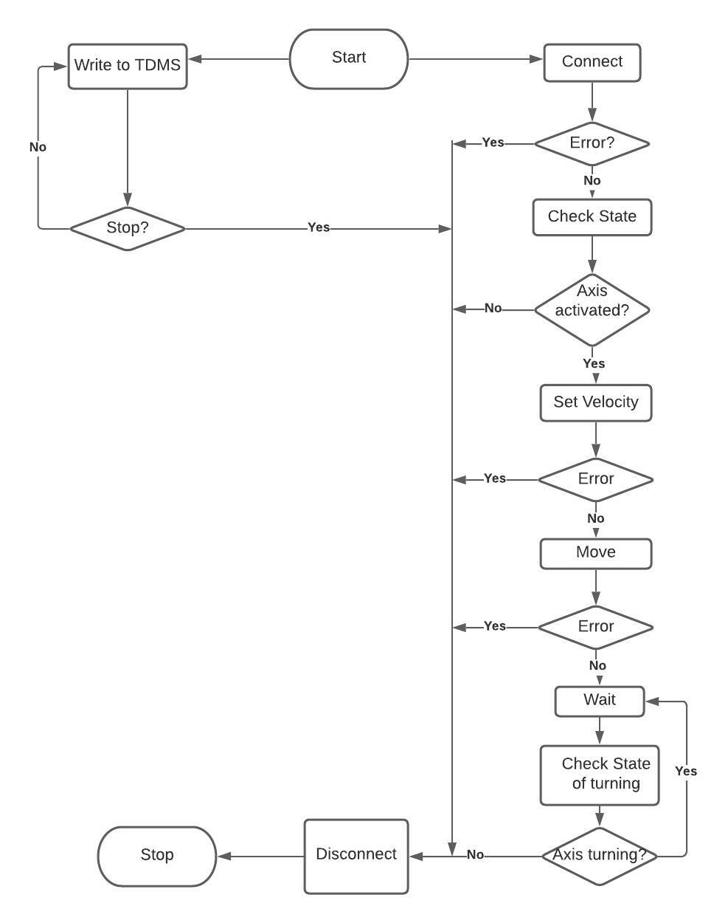
State Flow Diagram

Slide 14
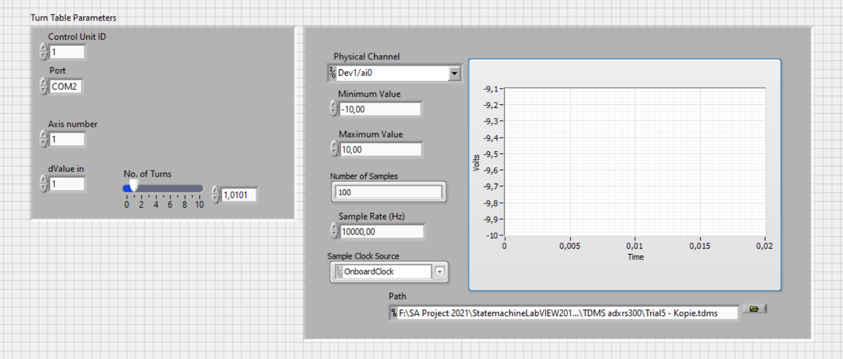
Front panel

Slide 15
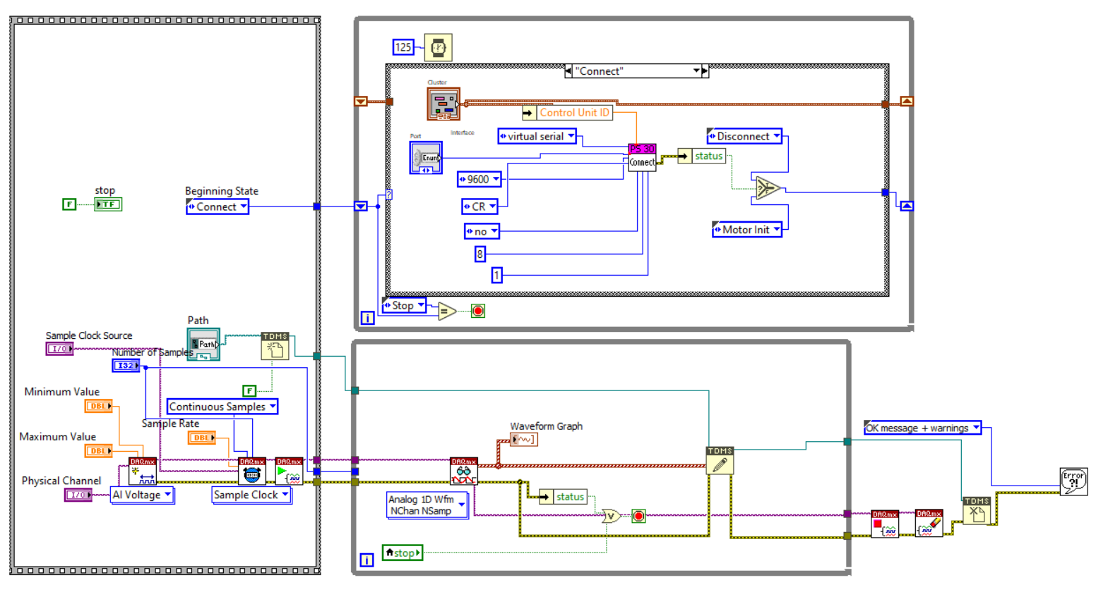
Block Diagram of VI

Slide 16
ADXRS 300
Sr No | Time | Turns | Angular Rate | Voltage Zero Value | Average Voltage Value | Sensitivity
 | (sec) | (deg) | (deg/s) | (V) | (V) | (mV/(deg/sec))
1 | 5,066 | -180 | -35,531 | 2.56 | 2,375 | 5,21
2 | 2,530 | -180 | -71,146 | 2.56 | 2,191 | 5,19
3 | 3,403 | 360 | 105,789 | 2.56 | 3,104 | 5,14
4 | 2,599 | -360 | -138,515 | 2.56 | 1,843 | 5,18
5 | 1,784 | 360 | 201,794 | 2.56 | 3,598 | 5,14
6 | 1,032 | -360 | -348,837 | 2.56 | 0,762 | 5,15
7 | 5,027 | 180 | 35,807 | 2.56 | 2,743 | 5,11
8 | 8,370 | -180 | -21,505 | 2.56 | 2,447 | 5,25
9 | 12,538 | 180 | 14,356 | 2.56 | 2,632 | 5,02
10 | 37,400 | -270 | -7,219 | 2.56 | 2,521 | 5,40
11 | 3,200 | 90 | 28,125 | 2.56 | 2,703 | 5,08

Slide 17
Sensitivity of ADXRS 300
Specified:
Sensitivity
4,6 - 5,4 mV/(deg/sec)
Observed:
Average Sensitivity
5,17 mV/(deg/sec)

Slide 18
Voltage vs Angular Rate Graph - ADXRS 300

Slide 19
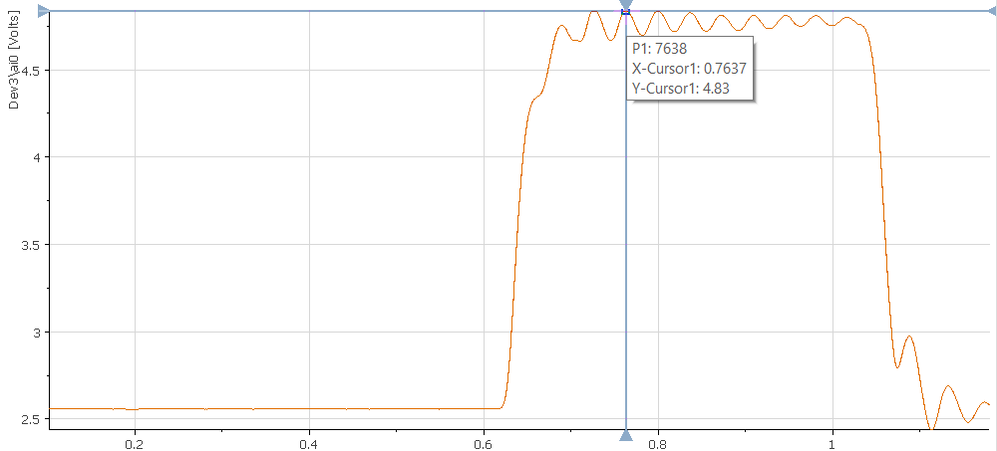
Saturation of ADXRS 300
Angular Rate = 400 deg/sec

Slide 20
Bosch SMG040
Sr no | Time | Turns | Angular Rate | Voltage Zero Value | Average Voltage Value | Sensitivity
 | (sec) | (deg) | (deg/s) | (V) | (V) | (mV/(deg/sec))
1 | 5,009 | 180 | 35,935 | 2,38 | 2,62 | 6,68
2 | 2,925 | 180 | 61,538 | 2,37 | 2,78 | 6,66
3 | 3,339 | -360 | -107,817 | 2,34 | 1,59 | 6,96
4 | 2,576 | 360 | 139,752 | 2,34 | 3,291 | 6,80
5 | 1,578 | -360 | -228,137 | 2,34 | 0,86 | 6,49
6 | 1,134 | 360 | 317,460 | 2,34 | 4,41 | 6,52
7 | 5,019 | -180 | -35,864 | 2,31 | 2,06 | 6,97
8 | 8,338 | 180 | 21,588 | 2,31 | 2,458 | 6,86
9 | 12,495 | -180 | -14,406 | 2,33 | 2,23 | 6,94
10 | 37,550 | 270 | 7,190 | 2,32 | 2,37 | 6,95
11 | 3,140 | -90 | -28,662 | 2,34 | 2,147 | 6,73

Slide 21
Sensitivity of Bosch SMG040
Specified:
Sensitivity
6,50 - 7,50 mV/(deg/sec)
Observed:
Average Sensitivity
6,78 mV/(deg/sec)

Slide 22
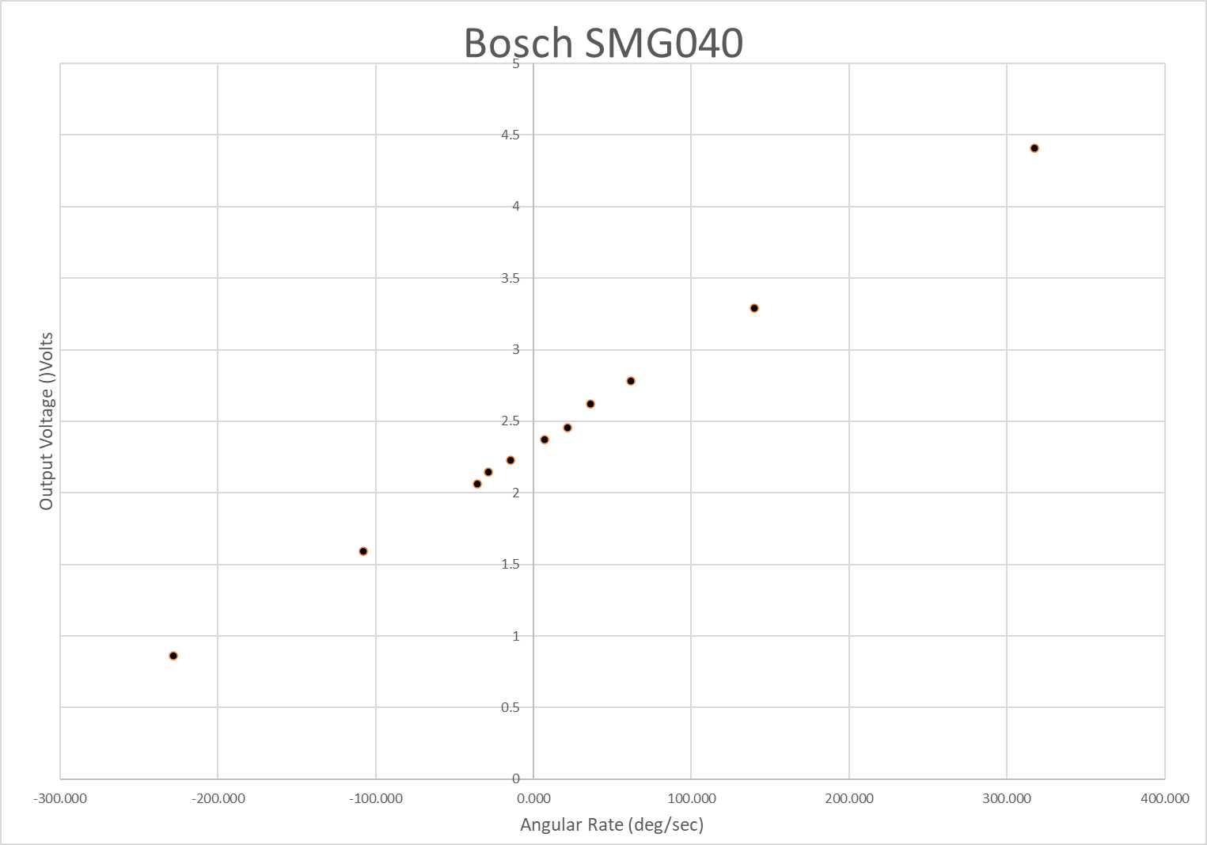
Voltage vs Angular Rate Graph - ADXRS 300

Slide 23
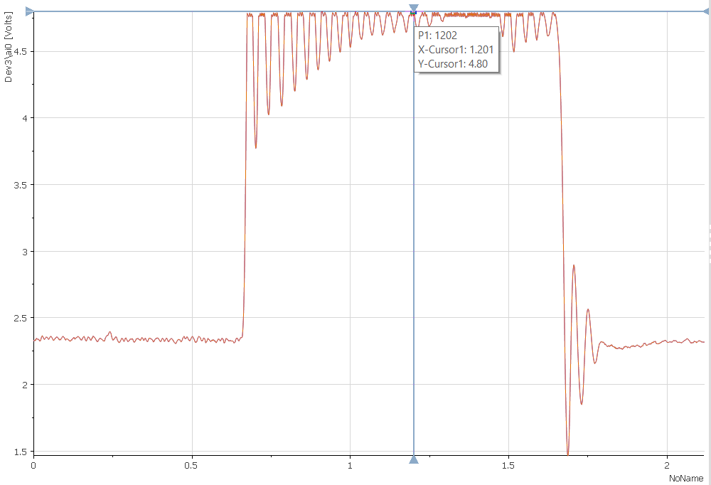
Saturation of Bosch SMG040
Angular Rate = 350 deg/sec

Slide 24
Conclusion
Property | ADXRS 300 | SMG040
Maximum Rate (deg/sec) | 350 | 300
Sensitivity (mV sec/deg) | 5,17 | 6,78
Zero Value Voltage (V) | 2,56 | 2,34

Slide 25
Thank you for your attention

